Slide 1
Publication Bias
What is it
  Statistically significant effects are more likely to be published
  Has many forms
    Outcomes that are selected for inclusion in a report
    Author’s desire to write-up the report
    Reviewers’ recommendations for publication
    Editor’s decision to publish
  Well established bias in the published literature
  Affect all forms of reviewing, not just meta-analysis

Slide 2
Publication Bias
What to do about it
  Search for and include unpublished studies
  Assess distribution of effect sizes for publication bias
    Compare results from published with unpublished studies
    Graphically examine a “funnel plot”
    “Adjust” distribution using the trim-and-fill method (Duvall and Tweedie)

Slide 3
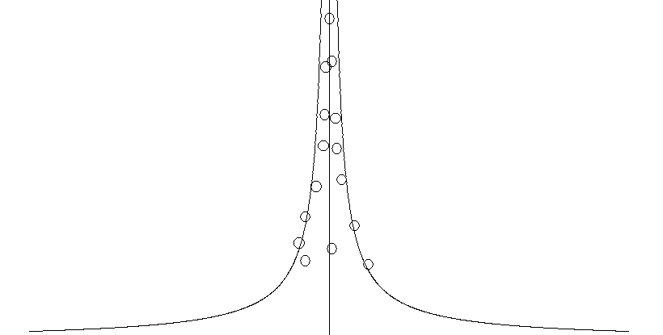
Example of a funnel plot

Slide 4
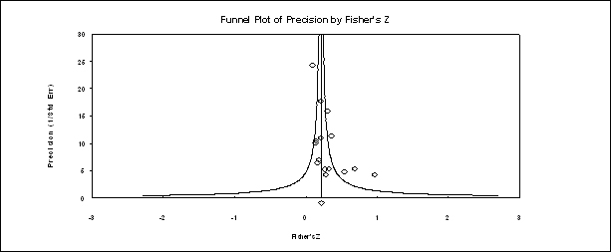
Example of a funnel plot
Courtesy of Michael A. McDaniel

